Slide 1
Input/Output Manipulation
Standard I/O
Formatted Output - printf
Formated Input - scanf
Variable length argument list
file access including FILE structure, fopen, stdin, sdtout and stderr
Error Handling including exit, perror and error.h
Line I/O
miscellaneous functions

Slide 2
Standard I/O
library implements a simple model of text input and output .
Streams: is a logical interface to the devices that are connected to the computer.
Three standard Streams :
Standard input (stdin)
Standard output (stdout)
Standard error (stderr)
Buffer associated with file stream

Slide 3
File types
Text File:
Human readable
In a text file ,each line of data ends with a newline character.
Each file ends with a special character called the end-of-file (EOF).
Text file may be of internal or external representations.
Eg: Int – internal 2 or 4 bytes
external : string of characters as decimal or hexadecimal (conversion by printf and scanf)

Slide 4
File types
Binary File
BF store data in the internal representation format.
A binary File is a collection of bytes.
Can be processed sequential or random.
Takes less space than text file.

Slide 5
Text file Example
getchar()
putchar()
#include<stdio.h>
#include<ctype.h>
int main()
{
int c;
while ((c=getchar()) != EOF)
putchar(tolower(c));
return 0;
}

Slide 6
Formatted Output - printf
The output function printf() translates internal values to characters.
Int printf(char *format, arg1,arg2,…)
Format string contains two types of objects
Ordinary characters
Conversion specifications
Starts with % ends with conversion characters.
Between
minus sign – left adjustment
Number – minimum field width
Period
Number, the precision
h or l (short or long)

Slide 7
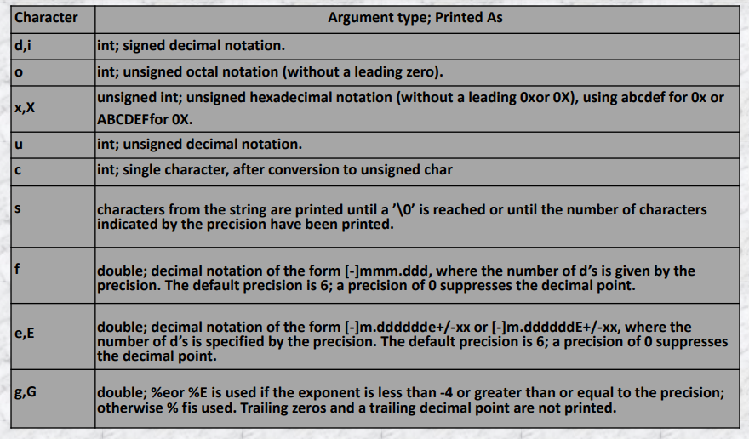
p % | Display the argument as an address in hexadecimal digits. No argument is converted, print a %

Slide 8
Example
7 7 007 5.10
7 7 007 5.10
7 7 007 5.10
#include<stdio.h>
main()
{
int a,b;
float c,d;
a = 15;
b = a / 2;
printf("%d\n",b);
printf("%3d\n",b);
printf("%03d\n",b);
c = 15.3;
d = c / 3;
printf("%3.2f\n",d);
}
#include<stdio.h>
main()
{
int Fahrenheit;
for (Fahrenheit = 0; Fahrenheit <= 300; Fahrenheit = Fahrenheit + 20)
printf("%3d %06.3f\n", Fahrenheit, (5.0/9.0)*(Fahrenheit-32));
}
7
7
007
5.10

Slide 9
Examples
#include<stdio.h>
main()
{
printf("The color: %s\n", "blue");
printf("First number: %d\n", 12345);
printf("Second number: %04d\n", 25);
printf("Third number: %i\n", 1234);
printf("Float number: %3.2f\n", 3.14159);
printf("Hexadecimal: %x\n", 255);
printf("Octal: %o\n", 255);
printf("Unsigned value: %u\n", 150);
printf("Just print the percentage sign %%\n", 10);
}
#include<stdio.h>
main()
{
printf(":%s:\n", "Hello, world!");
printf(":%15s:\n", "Hello, world!");
printf(":%.10s:\n", "Hello, world!");
printf(":%-10s:\n", "Hello, world!");
printf(":%-15s:\n", "Hello, world!");
printf(":%.15s:\n", "Hello, world!");
printf(":%15.10s:\n", "Hello, world!");
printf(":%-15.10s:\n", "Hello, world!");
}
:Hello, world!:
: Hello, world!:
:Hello, wor:
:Hello, world!:
:Hello, world! :
:Hello, world!:
: Hello, wor:
:Hello, wor :

Slide 10
Formated Input - scanf
scanf() reads characters from standard input, interprets them according to the specification in format, and stores the results through the remaining arguments.
int scanf(char *format,…)

Slide 11
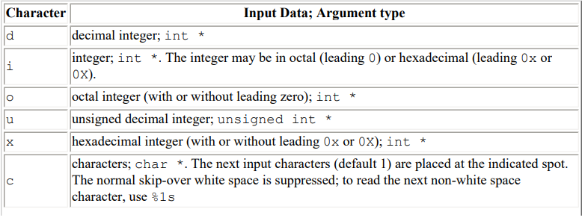
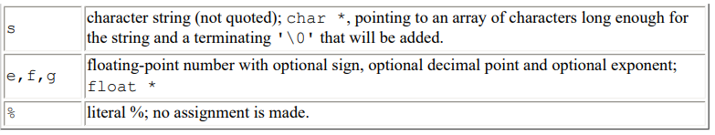

Slide 12
The conversion characters d, i, o, u, and x may be preceded by h to indicate that a pointer to short rather than int appears in the argument list, or by l (letter ell) to indicate that a pointer to long appears in the argument list.
#include <stdio.h>
main() /* rudimentary calculator */
{
double sum, v;
sum = 0;
while ((scanf("%lf",&v)) == 1)
printf("\t%.2f\n", sum += v);
return 0;
}

Slide 13
int day, year;
char monthname[20];
scanf("%d %s %d", &day, monthname, &year);
int day, month, year;
scanf("%d/%d/%d", &month, &day, &year);

Slide 14
File Access
File Handling is the storing of data in a file using a program. In C programming language, the programs store results, and other data of the program to a file using file handling in C.

Slide 15
Types of Files
Text Files
Binary Files

Slide 16
Basic File Operations
Creation of the new file
Opening an existing file
Reading from the file
Writing to the file
Close the file
Intially:
When working with files, you need to declare a pointer of type file. This declaration is needed for communication between the file and the program.
FILE *fp;

Slide 17
Opening File
We must open a file before it can be read, write, or update. The fopen() function is used to open a file.
The syntax of the fopen() is given below.
FILE *fopen( char * filename, const char * mode );
Example
fopen(“D:\\cprogram\\file1.txt","w"); fopen(“D:\\cprogram\\file2.bin","rb");

Slide 18
Mode | Description
r | opens a text file in read mode
w | opens a text file in write mode
a | opens a text file in append mode
r+ | opens a text file in read and write mode
w+ | opens a text file in read and write mode
a+ | opens a text file in read and append mode
rb | opens a binary file in read mode
wb | opens a binary file in write mode
ab | opens a binary file in append mode
rb+ | opens a binary file in read and write mode
wb+ | opens a binary file in read and write mode
ab+ | opens a binary file in read and append mode

Slide 19
Example
#include<stdio.h>
void main( )
{
FILE *fp ;
char ch ;
fp = fopen("file_handle.c","r") ;
while ( 1 )
{
ch = fgetc ( fp ) ;
if ( ch == EOF )
break ;
printf("%c",ch) ;
}
fclose (fp ) ;
}

Slide 20
Closing File
fclose()
The fclose() function is used to close a file. The file must be closed after performing all the operations on it.
The syntax of fclose() function is given below:
int fclose( FILE *fp );

Slide 21
Basic File functions
fopen()
fclose()
fprintf()
fscanf()
fputc()
fgetc()
fputs()
fgets()
fseek()
ftell()
rewind()

Slide 22
Writing to the File : fprintf()
The fprintf() function is used to write set of characters into file. It sends formatted output to a stream.
Syntax:
int fprintf(FILE *stream, char *format [, argument, ...])
Example
#include <stdio.h>
main(){
FILE *fp;
fp = fopen("file1.txt", "w");
fprintf(fp, "Advanced C Programming\n");
fclose(fp);
}

Slide 23
Reading from the File : fscanf()
The fscanf() function is used to read set of characters from file. It reads a word from the file and returns EOF at the end of file.
Syntax:
int fscanf(FILE *stream, const char *format [, argument, ...])
Example:
#include <stdio.h>
int main()
{
char b[255];
FILE *fp;
if ((fp = fopen("file1.txt","r")) == NULL)
{
printf("Error! opening file");
exit(1);
}
while(fscanf(fp, "%s", b)!=EOF)
printf("%s",b);
fclose(fp);
return 0;
}

Slide 24
Writing to the File : fputc()
The fputc() function is used to write a single character into file. It outputs a character to a stream.
Syntax:
int fputc(int c, FILE *stream)
Example:
#include <stdio.h>
main(){
FILE *fp;
fp = fopen("file1.txt", "w");
fputc('a',fp);
fclose(fp);
}

Slide 25
Reading from the File : fgetc()
The fgetc() function returns a single character from the file. It gets a character from the stream. It returns EOF at the end of file.
Syntax:
int fgetc(FILE *stream)
#include <stdio.h>
int main () {
FILE *fp;
int c;
fp = fopen("file1.txt","r");
while(1) {
c = fgetc(fp);
if( feof(fp) ) {
break ;
}
printf("%c", c);
}
fclose(fp);
return(0);
}

Slide 26
Line I/O
Syntax:
int fputs(const char *s, FILE *stream)
Example:
#include<stdio.h>
#include<conio.h>
main(){
FILE *fp;
fp=fopen("file2.txt","w");
fputs(“VIT UNIVERSITY",fp);
fclose(fp);
getch();
}
Syntax:
char* fgets(char *s, int n, FILE *stream)
Example:
#include<stdio.h>
main(){
FILE *fp;
char text[ 300];
fp=fopen(“file2.txt","r");
printf("%s",fgets(text,300,fp));
fclose(fp);
getch();
}

Slide 27
Error handling
stderr is an output stream typically used by programs to output error messages or diagnostics to the console.
Some of the errors that occurs in the files are listed below −
Trying to read beyond end of file.
Device over flow.
Trying to open an invalid file.
An invalid operation is performed by opening a file in a different mode.

Slide 28
File handling : error.h
Few methods and variables defined in error.h header file can be used to point out error using the return statement in a function.
in case of any error and a global variable errno is set with the error code
errno value | Error
1 | Operation not permitted
2 | No such file or directory
3 | No such process
4 | Interrupted system call
5 | I/O error
6 | No such device or address
7 | Argument list too long
8 | Exec format error
9 | Bad file number
10 | No child processes
11 | Try again
12 | Out of memory
13 | Permission denied

Slide 29
File handling : stderr, perror,strerror
The perror() function displays the string you pass to it, followed by a colon, a space, and then the textual representation of the current errno value.
The strerror() function, which returns a pointer to the textual representation of the current errno value.

Slide 30
File handling: Example
#include <stdio.h>
#include <errno.h>
#include <string.h>
int errno ;
int main () {
FILE * pf;
int errnum;
pf = fopen ("file3.txt", "r");
if (pf == NULL) {
errnum = errno;
fprintf(stderr, "Value of errno: %d\n", errno);
perror("Error printed by perror");
fprintf(stderr, "Error opening file: %s\n", strerror( errnum ));
} else {
fclose (pf);
}
return 0;
}

Slide 31
#include <stdio.h>
#include <stdlib.h>
main() {
int a = 20;
int b = 0;
int c;
if( b == 0){
fprintf(stderr, "Division by zero! Exiting...\n");
exit(-1);
}
c = a / b;
fprintf(stderr, "Value of quotient : %d\n", c );
exit(0);
}

Slide 32
File handling :ferror()
It is for detecting an error while performing read or write operations.
The syntax is as follows −
int ferror (file pointer);
It returns zero, if it is a success and returns as non-zero in other cases.
#include <stdio.h>
int main () {
FILE *fp;
char c;
fp = fopen("file.txt", "w");
c = fgetc(fp);
if( ferror(fp) ) {
printf("Error in reading from file : file.txt\n");
}
clearerr(fp);
if( ferror(fp) ) {
printf("Error in reading from file : file.txt\n");
}
fclose(fp);
return(0);
}

Slide 33
File handling :feof()
fclose (fp);
fp = fopen ("file4. txt", "r");
for (i=0; i<=100; i++){
n = getw (fp);
if (feof (fp)){
printf ("reached end of file");
break;
}
else{
printf ("%d", n);
}
}
fclose (fp);
return 0;
}
It is used for checking whether an end of the file has been reached or not.
The syntax is as follows −
int feof ( file pointer);
If it returns a non-zero then, it is success. Otherwise, It is zero.
#include<stdio.h>
main ( ){
FILE *fp;
int i,n;
fp = fopen ("file4. txt", "w");
for (i=0; i<=100;i= i+10){
putw (i, fp);
}

Slide 34
Working with binary file
Binary files are very similar to arrays of structures, except the structures are in a disk-file rather than an array in memory. Binary files have two features that distinguish them from text files:
You can instantly use any structure in the file.
You can change the contents of a structure anywhere in the file.
After you have opened the binary file, you can read and write a structure or seek a specific position in the file. A file position indicator points to record 0 when the file is opened.
The fread and fwrite function takes four parameters:
A memory address
Number of bytes to read per block
Number of blocks to read
A file variable
fread(&my_record,sizeof(struct rec),1,ptr_myfile);

Slide 35
Binary file : fwrite()
#include<stdio.h>
struct rec
{
int x,y,z;
};
int main()
{
int c;
FILE *fp;
struct rec r;
fp=fopen("binaryfile.bin","wb");
if (!fp)
{
printf("Unable to open file!");
return 1;
}
for ( c=1; c <= 10; c++)
{
r.x= c;
fwrite(&r,sizeof(struct rec),1,fp);
}
fclose(fp);
return 0;
}

Slide 36
Binary file : fread()
#include<stdio.h>
struct rec
{
int x,y,z;
};
int main()
{
int c;
FILE *fp;
struct rec r;
fp=fopen("binaryfile.bin","rb");
if (!fp)
{
printf("Unable to open file!");
return 1;
}
for ( c=1; c <= 10; c++)
{
fread(&r,sizeof(struct rec),1,fp);
printf("%d\n",r.x);
}
fclose(fp);
return 0;
}

Slide 37
Random Access To File
There is no need to read each record sequentially, if we want to access a particular record. C supports these functions for random access file processing.
fseek()
ftell()
rewind()

Slide 38
fseek()
This function is used for seeking the pointer position in the file at the specified byte. Syntax: fseek( file pointer, displacement, pointer position); file pointer ---- It is the pointer which points to the file. displacement ---- It is positive or negative. This is the number of bytes which are skipped backward (if negative) or forward( if positive) from the current position. This is attached with L because this is a long integer. Pointer position: Value pointer position
0 Beginning of file.
1 Current position
2 End of file
Ex:
1) fseek( p,10L,0) 2)fseek( p,5L,1) 3)fseek(p,-5L,1)

Slide 39
ftell() & rewind()
This function returns the value of the current pointer position in the file. The value is count from the beginning of the file.
Syntax: ftell(fptr);
rewind()
This function is used to move the file pointer to the beginning of the given file.
Syntax: rewind( fptr);

Slide 40
Example
#include<stdio.h>
void main()
{
FILE *fp;
char ch;int n;
fp=fopen("file1.txt", "r");
if(fp==NULL)
printf("file cannot be opened");
else
{
printf("Enter value of n to read last ‘n’ characters");
scanf("%d",&n);
fseek(fp,n,1);
while((ch=fgetc(fp))!=EOF)
{
printf("%c",ch);
}
}
fclose(fp);
getch();
}

Slide 41
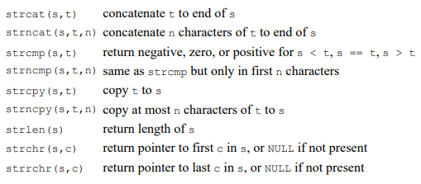
Miscellaneous functions
String operations

Slide 42

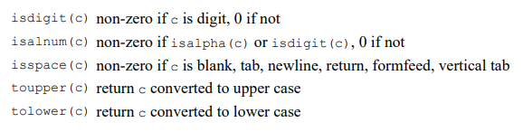
Character class testing and conversion

Slide 43
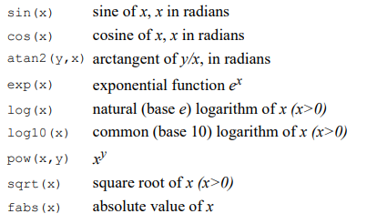
Mathematical functions

